Slide 1
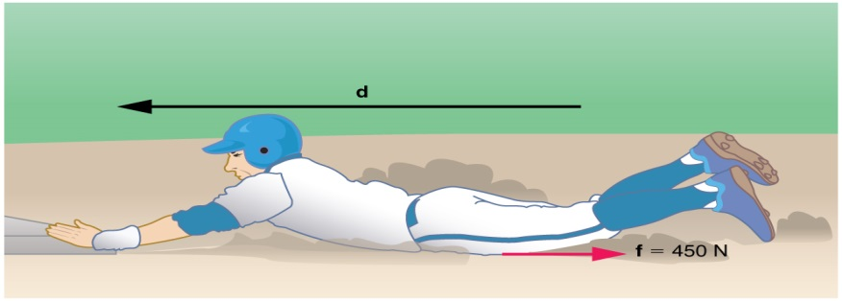
1. Calculate the distance the 65.0-kg baseball player slides, given that his initial speed is 6.00 m/s and the force of friction against him is a constant 450 N. a) Using energy considerations b) Using kinematic equations

Slide 2
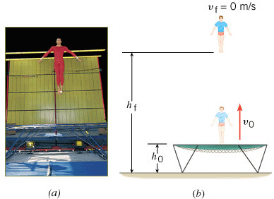
A Gymnast on a Trampoline
A gymnast springs vertically upward from a trampoline. The gymnast leaves the trampoline at a height of 1.20 m and reaches a maximum height of 4.80 m before falling back down. All heights are measured with respect to the ground. Ignoring air resistance, determine the initial speed v₀ with which the gymnast leaves the trampoline.

Slide 3
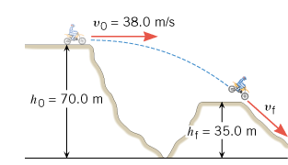
A Daredevil Motorcyclist
A motorcyclist is trying to leap across the canyon shown in Figure by driving horizontally off the cliff at a speed of 38.0 m/s. Ignoring air resistance, find the speed with which the cycle strikes the ground on the other side.

Slide 4
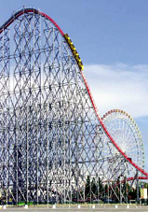
Roller Coaster (Ideal)
The ride includes a vertical drop of 93.5 m. The coaster has a speed of 3.0 m/s at the top of the drop. Neglect friction and find the speed of the riders at the bottom.

Slide 5
Non-conservative Forces and the Work–Energy Theorem
In the roller coaster example, we ignored non-conservative forces, such as friction. In reality, however, such forces are present when the roller coaster descends. The actual speed of the riders at the bottom is 41.0 m/s. Assuming again that the coaster has a speed of 3.0 m/s at the top, find the work done by non-conservative forces on a 55.0-kg rider during the descent.

